Slide 1
Theory behind GAN
Notes:
Q: min-max max-min

Slide 2
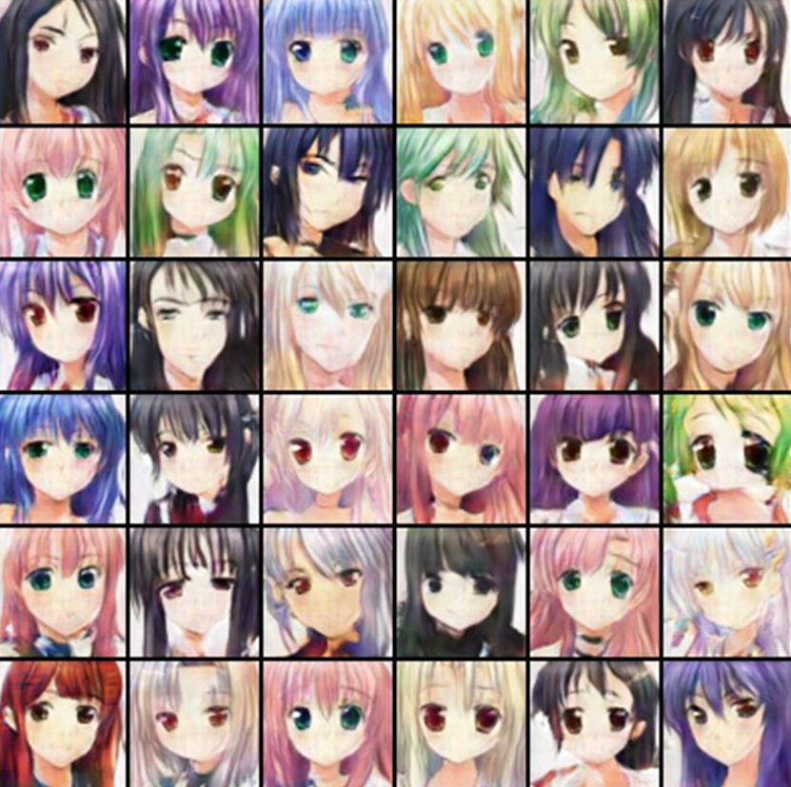












Generation
Using Generative Adversarial Network (GAN)
Drawing?

Slide 3
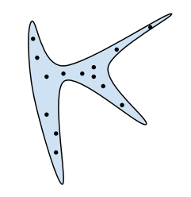

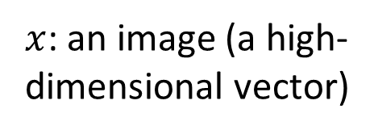


Generation
$x$: an image (a high-dimensional vector)
We want to find data distribution $P_{data}\left(x\right)$
$$P_{data}\left(x\right)$$
High
Probability
Image
Space
Low
Probability

Slide 4

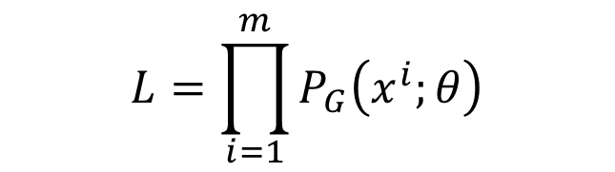
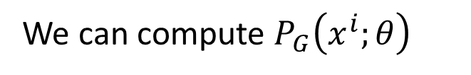
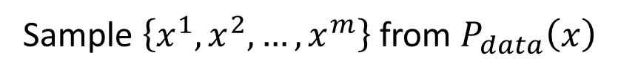

Maximum Likelihood Estimation
Given a data distribution $P_{data}\left(x\right)$ (We can sample from it.)
We have a distribution $P_{G}\left(x;θ\right)$ parameterized by $θ$
We want to find $θ$ such that $P_{G}\left(x;θ\right)$ close to $P_{data}\left(x\right)$
E.g. $P_{G}\left(x;θ\right)$ is a Gaussian Mixture Model, $θ$ are means and variances of the Gaussians
Sample $\left\{x^{1},x^{2},…,x^{m}\right\}$ from $P_{data}\left(x\right)$
We can compute $P_{G}\left(x^{i};θ\right)$
Likelihood of generating the samples
$$L=\prod_{i=1}^{m}{P_{G}\left(x^{i};θ\right)}$$
Find $θ^{∗}$ maximizing the likelihood

Slide 5

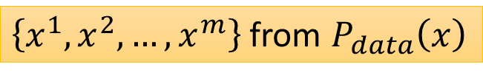

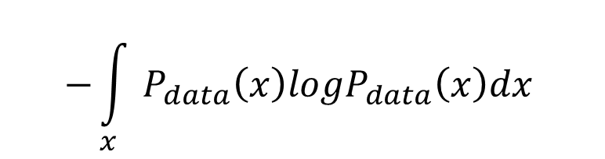
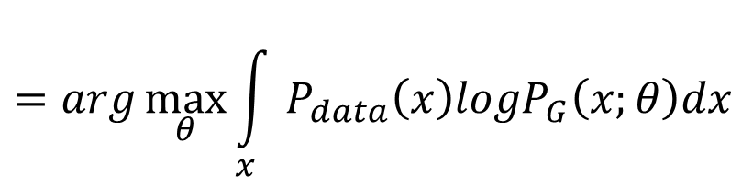

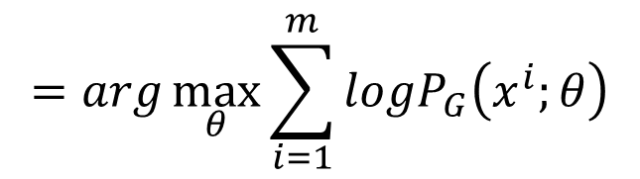
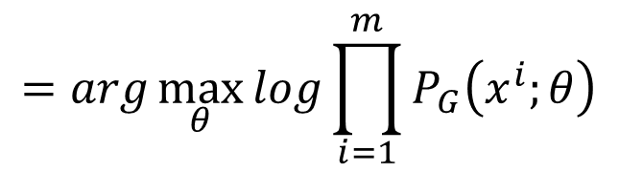
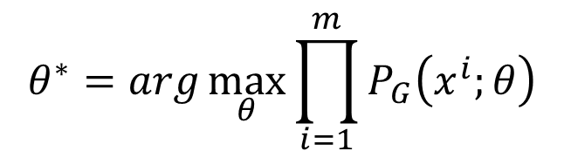
Maximum Likelihood Estimation = Minimize KL Divergence
$$θ^{∗}=arg\max_{θ}{\prod_{i=1}^{m}{P_{G}\left(x^{i};θ\right)}}$$
$$=arg\max_{θ}{log\prod_{i=1}^{m}{P_{G}\left(x^{i};θ\right)}}$$
$$=arg\max_{θ}{\sum_{i=1}^{m}{logP_{G}\left(x^{i};θ\right)}}$$
$\left\{x^{1},x^{2},…,x^{m}\right\}$ from $P_{data}\left(x\right)$
$$≈arg\max_{θ}{E_{x\sim P_{data}}[logP_{G}\left(x;θ\right)] }$$
$$=arg\max_{θ}{\int_{x}{P_{data}\left(x\right)logP_{G}\left(x;θ\right)dx} }$$
$$−{\int_{x}{P_{data}\left(x\right)logP_{data}\left(x\right)dx} }$$
与G无关构造kl散度
$$=arg\min_{θ}{KL\left(P_{data}||P_{G}\right) }$$
How to define a general $P_{G}$?
当P_{G}不是高斯呢？

Slide 6


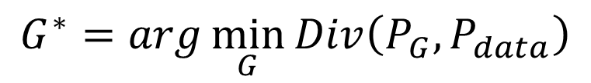





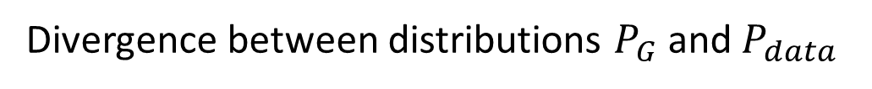
Generator
$x$: an image (a high-dimensional vector)
A generator G is a network. The network defines a probability distribution $P_{G}$
$$P_{G}\text{(}\text{x}\text{)}$$
$$P_{data}\left(x\right)$$
Normal Distribution
generator
G
$$z$$
$$x=G\left(z\right)$$
as close as possible
$$G^{∗}=arg\min_{G}{Div\left(P_{G},P_{data}\right)}$$
关键这么计算目标函数DIV呢
Divergence between distributions $P_{G}$ and $P_{data}$
How to compute the divergence?

Slide 7

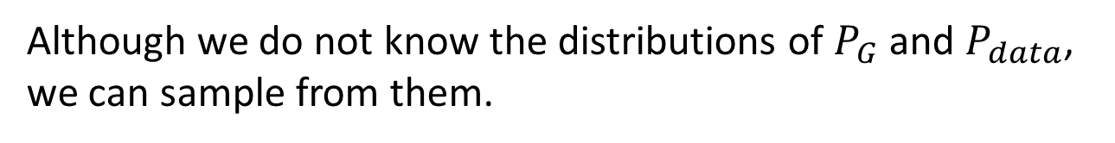
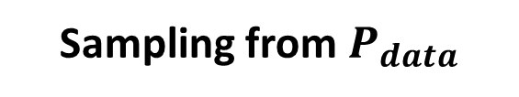
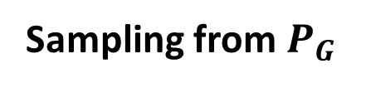
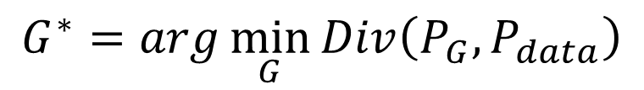
Discriminator
$$G^{∗}=arg\min_{G}{Div\left(P_{G},P_{data}\right)}$$
Although we do not know the distributions of $P_{G}$ and $P_{data}$, we can sample from them.
sample
Database
Sampling from $P_{data}$
sample from normal
G
vector
vector
vector
vector
Sampling from $P_{G}$

Slide 8

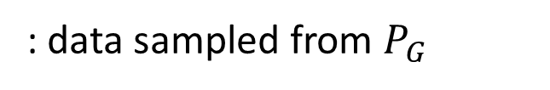
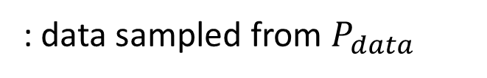
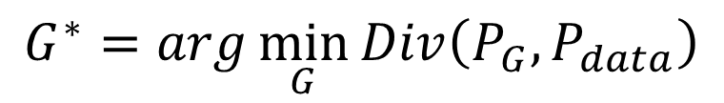
Discriminator
$$G^{∗}=arg\min_{G}{Div\left(P_{G},P_{data}\right)}$$
: data sampled from $P_{data}$
Using the example objective function is exactly the same as training a binary classifier.
: data sampled from $P_{G}$
Discriminator
train
Sigmoid Output
Example Objective Function for D
$$V\left(G,D\right)=E_{x∼P_{data}}\left[logD\left(x\right)\right]+E_{x∼P_{G}}\left[log\left(1−D\left(x\right)\right)\right]$$
(G is fixed)
Training:
$$D^{∗}=arg\max_{D}{V\left(D,G\right)}$$
The maximum objective value is related to JS divergence.
[Goodfellow, et al., NIPS, 2014]

Slide 9

Discriminator
$$G^{∗}=arg\min_{G}{Div\left(P_{G},P_{data}\right)}$$
: data sampled from $P_{data}$
Training:
: data sampled from $P_{G}$
$$D^{∗}=arg\max_{D}{V\left(D,G\right)}$$
Discriminator
train
small divergence
hard to discriminate
(cannot make objective large)
Discriminator
train
large divergence
easy to discriminate

Slide 10


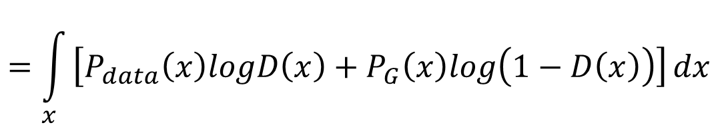
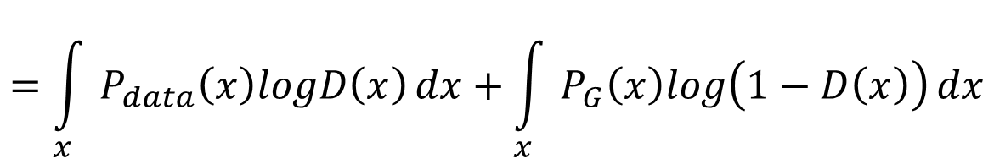
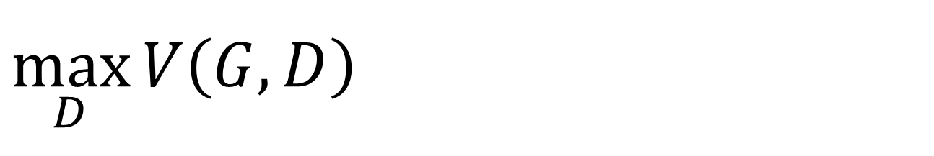
$$\max_{D}{V\left(G,D\right)}$$
$$V=E_{x∼P_{data}}\left[logD\left(x\right)\right]$$
$$+E_{x∼P_{G}}\left[log\left(1−D\left(x\right)\right)\right]$$
Given G, what is the optimal D* maximizing
Given x, the optimal D* maximizing
$$V=E_{x∼P_{data}}\left[logD\left(x\right)\right]+E_{x∼P_{G}}\left[log\left(1−D\left(x\right)\right)\right]$$
$$=\int_{x}{P_{data}\left(x\right)logD\left(x\right)}dx+\int_{x}{P_{G}\left(x\right)log\left(1−D\left(x\right)\right)}dx$$
$$=\int_{x}{\left[P_{data}\left(x\right)logD\left(x\right)+P_{G}\left(x\right)log\left(1−D\left(x\right)\right)\right]}dx$$
Assume that D(x) can be any function
每一个x都对应可能有不同D
$$P_{data}\left(x\right)logD\left(x\right)+P_{G}\left(x\right)log\left(1−D\left(x\right)\right)$$

Slide 11



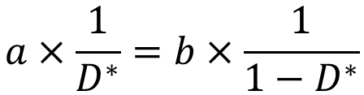

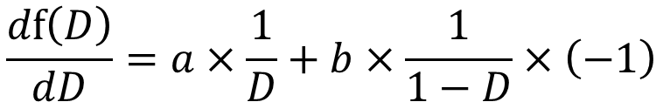


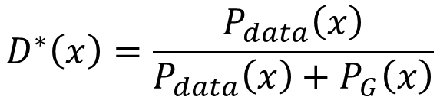
$$\max_{D}{V\left(G,D\right)}$$
$$V=E_{x∼P_{data}}\left[logD\left(x\right)\right]$$
$$+E_{x∼P_{G}}\left[log\left(1−D\left(x\right)\right)\right]$$
Given x, the optimal D* maximizing
Find D* maximizing:
$$P_{data}\left(x\right)logD\left(x\right)+P_{G}\left(x\right)log\left(1−D\left(x\right)\right)$$
a
D
b
D
$$f\left(D\right)=alog(D)+blog\left(1−D\right)$$
$$\frac{df\left(D\right)}{dD}=a×\frac{1}{D}+b×\frac{1}{1−D}×\left(−1\right)$$
$$=0$$
$$a×\frac{1}{D^{∗}}=b×\frac{1}{1−D^{∗}}$$
$$a×\left(1−D^{∗}\right)=b×D^{∗}$$
$$a−aD^{∗}=bD^{∗}$$
$$a=\left(a+b\right)D^{∗}$$
$$D^{∗}=\frac{a}{a+b}$$
$$D^{∗}\left(x\right)=\frac{P_{data}\left(x\right)}{P_{data}\left(x\right)+P_{G}\left(x\right)}$$
0 <
< 1
Notes:
sigmoid

Slide 12



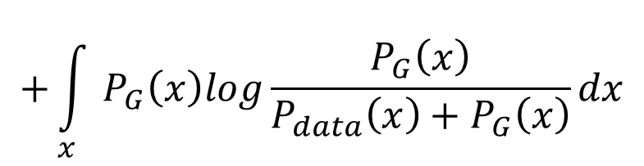

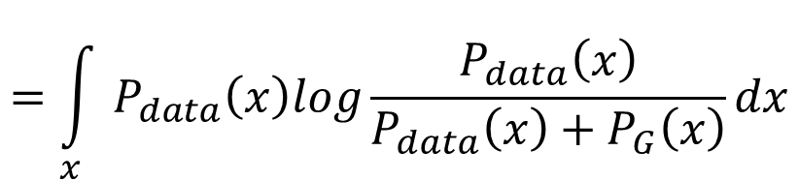
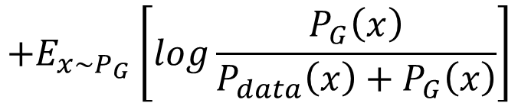
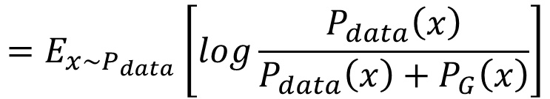


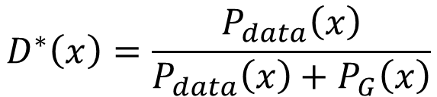
$$\max_{D}{V\left(G,D\right)}$$
$$V=E_{x∼P_{data}}\left[logD\left(x\right)\right]$$
$$+E_{x∼P_{G}}\left[log\left(1−D\left(x\right)\right)\right]$$
$$\max_{D}{V\left(G,D\right)}$$
$$=V\left(G,D^{∗}\right)$$
$$D^{∗}\left(x\right)=\frac{P_{data}\left(x\right)}{P_{data}\left(x\right)+P_{G}\left(x\right)}$$
$$=E_{x∼P_{data}}\left[log\frac{P_{data}\left(x\right)}{P_{data}\left(x\right)+P_{G}\left(x\right)}\right]$$
$$+E_{x∼P_{G}}\left[log\frac{P_{G}\left(x\right)}{P_{data}\left(x\right)+P_{G}\left(x\right)}\right]$$
$$\frac{1}{2}$$
$$=\int_{x}{P_{data}\left(x\right)log\frac{P_{data}\left(x\right)}{P_{data}\left(x\right)+P_{G}\left(x\right)}}dx$$
$$\frac{1}{2}$$
2
$$+\int_{x}{P_{G}\left(x\right)log\frac{P_{G}\left(x\right)}{P_{data}\left(x\right)+P_{G}\left(x\right)}}dx$$
$$+2log\frac{1}{2}$$
$$−2log2$$
2
Notes:
Converge

Slide 13


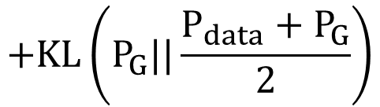
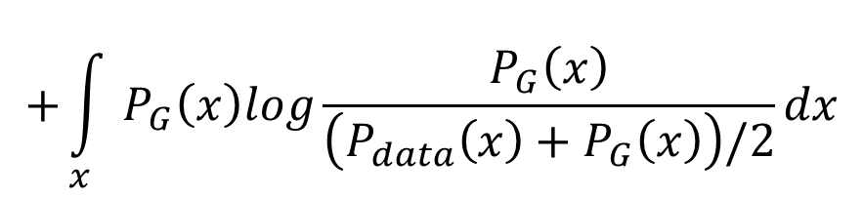
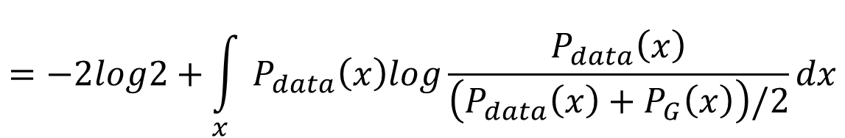

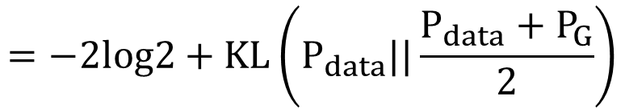
$$\max_{D}{V\left(G,D\right)}$$
$$\max_{D}{V\left(G,D\right)}$$
$$=V\left(G,D^{∗}\right)$$
$$D^{∗}\left(x\right)=\frac{P_{data}\left(x\right)}{P_{data}\left(x\right)+P_{G}\left(x\right)}$$
$$=−2log2+\int_{x}{P_{data}\left(x\right)log\frac{P_{data}\left(x\right)}{\left(P_{data}\left(x\right)+P_{G}\left(x\right)\right)/2}}dx$$
$$+\int_{x}{P_{G}\left(x\right)log\frac{P_{G}\left(x\right)}{\left(P_{data}\left(x\right)+P_{G}\left(x\right)\right)/2}}dx$$
$$=−2log2+KL\left(P_{data}||\frac{P_{data}+P_{G}}{2}\right)$$
$$+KL\left(P_{G}||\frac{P_{data}+P_{G}}{2}\right)$$
$$=−2log2+2JSD\left(P_{data}||P_{G}\right)$$
Jensen-Shannon divergence

Slide 14










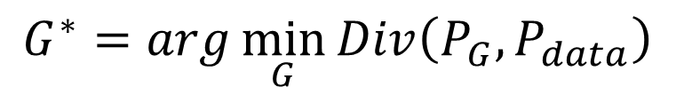



$$G^{∗}=arg\min_{G}{Div\left(P_{G},P_{data}\right)}$$
$$\max_{D}{V\left(G,D\right)}$$
$$D^{∗}=arg\max_{D}{V\left(D,G\right)}$$
The maximum objective value is related to JS divergence.
$$V\left(G_{1} ,D\right)$$
$$V\left(G_{2} ,D\right)$$
$$V\left(G_{3} ,D\right)$$
$$V\left(G_{1} ,D_{1}^{∗}\right)$$
$$D$$
$$D$$
$$D$$
$$G_{1}$$
$$G_{2}$$
$$G_{3}$$
Divergence between $P_{G_{1}}$ and $P_{data}$

Slide 15


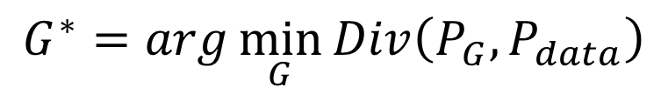
[Goodfellow, et al., NIPS, 2014]
$$G^{∗}=arg\min_{G}{Div\left(P_{G},P_{data}\right)}$$
$$\max_{D}{V\left(G,D\right)}$$
$$D^{∗}=arg\max_{D}{V\left(D,G\right)}$$
The maximum objective value is related to JS divergence.
Initialize generator and discriminator
In each training iteration:
Step 1: Fix generator G, and update discriminator D
Step 2: Fix discriminator D, and update generator G

Slide 16
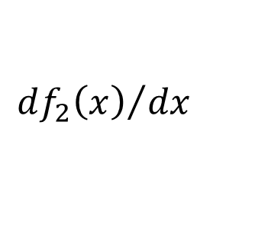
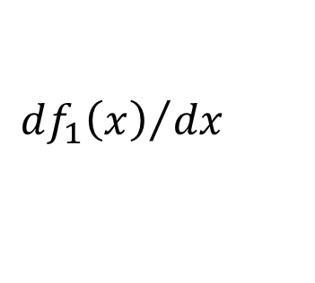






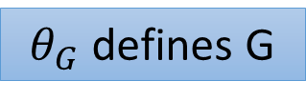

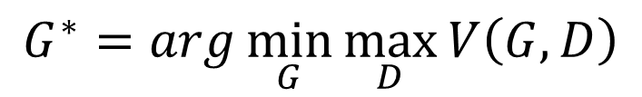

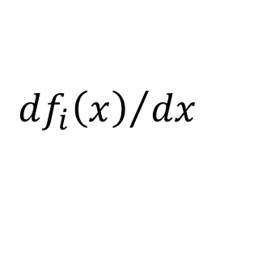


Algorithm
$$G^{∗}=arg\min_{G}{\max_{D}{V\left(G,D\right)}}$$
$$L\left(G\right)$$
To find the best G minimizing the loss function $L\left(G\right)$,
$$θ_{G}←θ_{G}−η{∂L\left(G\right)}/{∂θ_{G}}$$
$θ_{G}$ defines G
$$\frac{df\left(x\right)}{dx}=?$$
$${df_{i}\left(x\right)}/{dx}$$
$$f\left(x\right)=max⁡\{f_{1}\left(x\right),f_{2}\left(x\right),f_{3}\left(x\right)\}$$
If $f_{i}\left(x\right)$ is the max one
$$f_{1}\left(x\right)$$
$$f_{3}\left(x\right)$$
$$f_{2}\left(x\right)$$
$${df_{1}\left(x\right)}/{dx}$$
$${df_{2}\left(x\right)}/{dx}$$
$${df_{3}\left(x\right)}/{dx}$$

Slide 17



Algorithm
$$G^{∗}=arg\min_{G}{\max_{D}{V\left(G,D\right)}}$$
$$L\left(G\right)$$
Given $G_{0}$
Find $D_{0}^{∗}$ maximizing $V\left(G_{0},D\right)$
$θ_{G}←θ_{G}−η{∂V\left(G,D_{0}^{∗}\right)}/{∂θ_{G}}$ Obtain $G_{1}$
Find $D_{1}^{∗}$ maximizing $V\left(G_{1},D\right)$
$θ_{G}←θ_{G}−η{∂V\left(G,D_{1}^{∗}\right)}/{∂θ_{G}}$ Obtain $G_{2}$
……
Using Gradient Ascent
$V\left(G_{0},D_{0}^{∗}\right)$ is the JS divergence between $P_{data}\left(x\right)$ and $P_{G_{0}}\left(x\right)$
Decrease JS divergence(?)
$V\left(G_{1},D_{1}^{∗}\right)$ is the JS divergence between $P_{data}\left(x\right)$ and $P_{G_{1}}\left(x\right)$
Decrease JS divergence(?)

Slide 18









Algorithm
$$G^{∗}=arg\min_{G}{\max_{D}{V\left(G,D\right)}}$$
$$L\left(G\right)$$
Given $G_{0}$
Find $D_{0}^{∗}$ maximizing $V\left(G_{0},D\right)$
$θ_{G}←θ_{G}−η{∂V\left(G,D_{0}^{∗}\right)}/{∂θ_{G}}$ Obtain $G_{1}$
$V\left(G_{0},D_{0}^{∗}\right)$ is the JS divergence between $P_{data}\left(x\right)$ and $P_{G_{0}}\left(x\right)$
Decrease JS divergence(?)
$$V\left(G_{0} ,D_{0}^{∗} \right)$$
smaller
$$V\left(G_{1} ,D_{0}^{∗} \right)$$
……
$$V\left(G_{1} ,D_{1}^{∗} \right)$$
Assume $D_{0}^{∗}≈D_{1}^{∗}$
$$D_{0}^{∗}$$
$$D_{0}^{∗}$$
Don’t update G too much
$$V\left(G_{0} ,D\right)$$
$$V\left(G_{1} ,D\right)$$
Notes:
這頁對嗎？

Slide 19




In practice …
$$V=E_{x∼P_{data}}\left[logD\left(x\right)\right]$$
$$+E_{x∼P_{G}}\left[log\left(1−D\left(x\right)\right)\right]$$
Given G, how to compute $\max_{D}{V\left(G,D\right)}$
Sample $\left\{x^{1},x^{2},…,x^{m}\right\}$ from $P_{data}\left(x\right)$, sample $\left\{{\tilde{x}}^{1},{\tilde{x}}^{2},…,{\tilde{x}}^{m}\right\}$ from generator $P_{G}\left(x\right)$
$$\tilde{V}=\frac{1}{m}\sum_{i=1}^{m}{logD\left(x^{i}\right)}+\frac{1}{m}\sum_{i=1}^{m}{log\left(1−D\left({\tilde{x}}^{i}\right)\right)}$$
Maximize
=
Binary Classifier
D is a binary classifier with sigmoid output (can be deep)
$\left\{x^{1},x^{2},…,x^{m}\right\}$ from $P_{data}\left(x\right)$
Positive examples
$\left\{{\tilde{x}}^{1},{\tilde{x}}^{2},…,{\tilde{x}}^{m}\right\}$ from $P_{G}\left(x\right)$
Negative examples
Minimize Cross-entropy

Slide 20



Initialize $θ_{d}$ for D and $θ_{g}$ for G
Algorithm
Can only find lower bound of
$$\max_{D}{V\left(G,D\right)}$$
In each training iteration:
Sample m examples $\left\{x^{1},x^{2},…,x^{m}\right\}$ from data distribution $P_{data}\left(x\right)$
Sample m noise samples $\left\{z^{1},z^{2},…,z^{m}\right\}$ from the prior $P_{prior}\left(z\right)$
Obtaining generated data $\left\{{\tilde{x}}^{1},{\tilde{x}}^{2},…,{\tilde{x}}^{m}\right\}$, ${\tilde{x}}^{i}=G\left(z^{i}\right)$
Update discriminator parameters $θ_{d}$ to maximize
$\tilde{V}=\frac{1}{m}\sum_{i=1}^{m}{logD\left(x^{i}\right)}+\frac{1}{m}\sum_{i=1}^{m}{log\left(1−D\left({\tilde{x}}^{i}\right)\right)}$
$θ_{d}←θ_{d}+η∇\tilde{V}\left(θ_{d}\right)$
Sample another m noise samples $\left\{z^{1},z^{2},…,z^{m}\right\}$ from the prior $P_{prior}\left(z\right)$
Update generator parameters $θ_{g}$ to minimize
$\tilde{V}=\frac{1}{m}\sum_{i=1}^{m}{logD\left(x^{i}\right)}+\frac{1}{m}\sum_{i=1}^{m}{log\left(1−D\left(G\left(z^{i}\right)\right)\right)}$
$θ_{g}←θ_{g}−η∇\tilde{V}\left(θ_{g}\right)$
Learning
D
Repeat k times
Learning
G
Only Once
Notes:
位什麼要 1- 啊

Slide 21







Objective Function for Generator in Real Implementation
$$V=E_{x∼P_{data}}\left[logD\left(x\right)\right]$$
$$−log\left(D\left(x\right)\right)$$
$$+E_{x∼P_{G}}\left[log\left(1−D\left(x\right)\right)\right]$$
Slow at the beginning
Minimax GAN (MMGAN)
$$D\left(x\right)$$
$$V=E_{x∼P_{G}}\left[−log\left(D\left(x\right)\right)\right]$$
$$log\left(1−D\left(x\right)\right)$$
Real implementation:
label x from P_{G} as positive
Non-saturating GAN (NSGAN)

